Slide 1
Optimizing Algorithms for Immune Shielding on Networks
Andreea Magalie, Jiajia Xie, Haotian Yin

Slide 2
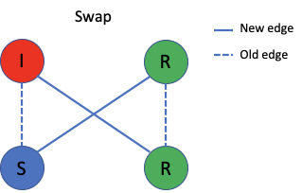
Introduction and Motivation
Can we manage epidemics in the absence of a vaccine aside from social distancing and isolation of infections?
Maintaining the schedule is important (HealthCare)
People who have been infected are immune to the disease
Propose Method: Immune Shielding

Slide 3
Model: Stochastic SIR
𝛃
𝛄
S
I
R
For each time step, an edge can be SI, SS, RR, SR …
SI is considered a high-risk edge

Slide 4
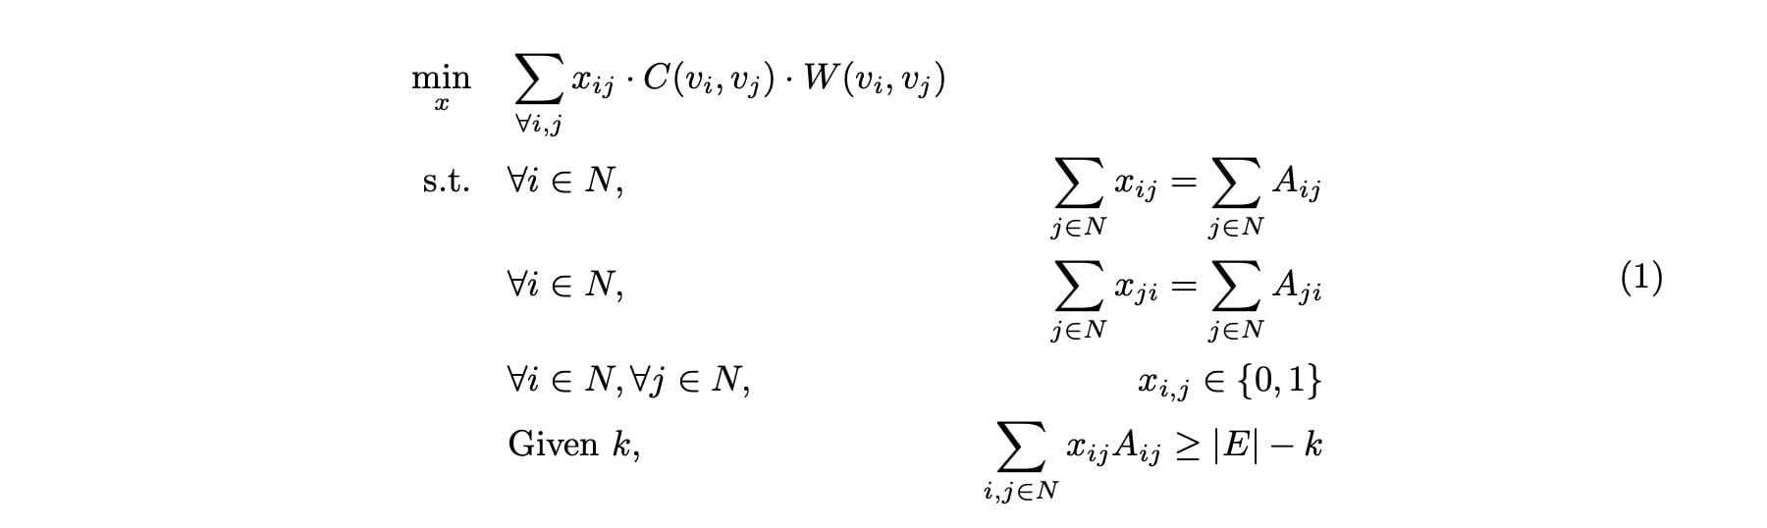
Formulation
Problem: Given an contact network G(V,E), and each edge’s category (SS, SI, RR, SR ...), can we rewire the entire network but maintain the degree for each node the same as the previous so that the number of SI edges is minimized?
We formulate this problem as an integer programming problem with x_{ij} as the binary decision variable. C(.) returns the risk of an edge, W(.) denotes the weight of an edge.
K is the budget constraint for swapping edges.
Note that: Any IP problem is NP-Hard!

Slide 5
Proposed Approximation Algorithms
minAreg - On regular networks
Connect infected nodes I to other I and R nodes
Connect the rest of the edges
Lots of edge cases and creating an adj matrix from scratch is hard
[4,1,1,1]

Slide 6
Proposed Approximation Algorithms
GreedySI
Try to swap SI with an RR edge
If there is no RR anymore, swap with an SR edge. Outcome must be (SR, IR)
If the current pair of edges cannot be swapped (edge already exist), drop the current pair and go to the next pair of candidate.
GreedySI+
Similar to GreedySI, but sort the SI and (RR/SR) edges in order based on weight.
For each (i, j) ∈ E, E is the set of edges, weight is calculated by w_{ij} = p_{i}*q_{j} , where p and q are the corresponding left and right eigenvectors of its largest eigenvalues of the adjacency matrix A of the graph G(V,E).

Slide 7
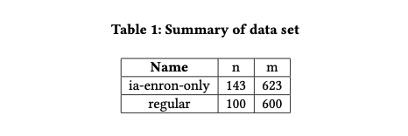
Data
Source: http://networkrepository.com/

Slide 8
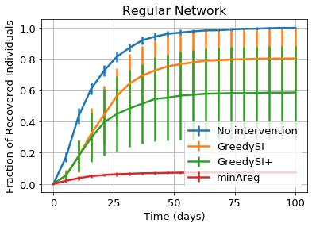
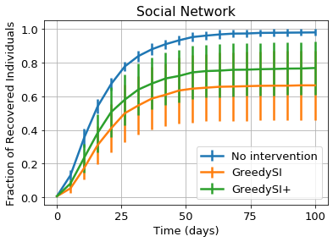
Experiment 1: No restrictions
All interventions do well!
minAreg >> GreedySI, GreedySI+
GreedySI+ vs GreedySI: undecided

Slide 9
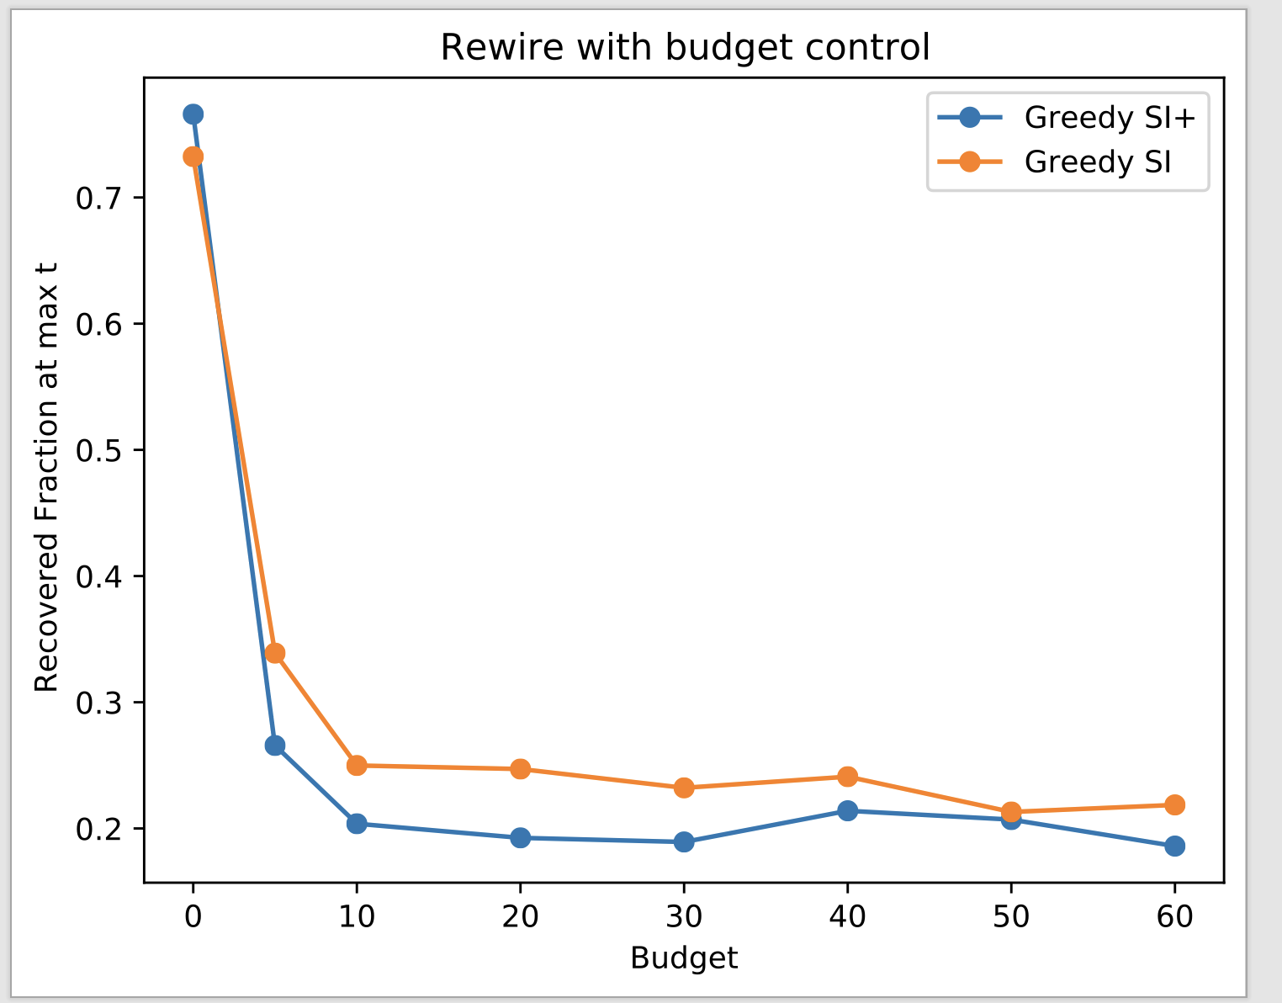
Experiment 2: Varying number of Intervention
Both Greedy SI and Greedy SI+ will reduce the size of an outbreak as budget becomes larger
Threshold around 10
Past threshold, size of the outbreak remain nearly unchanged
Greedy SI+ tried to take out the edges that have larger effects on the largest eigenvalue of the adj_matrix

Slide 10
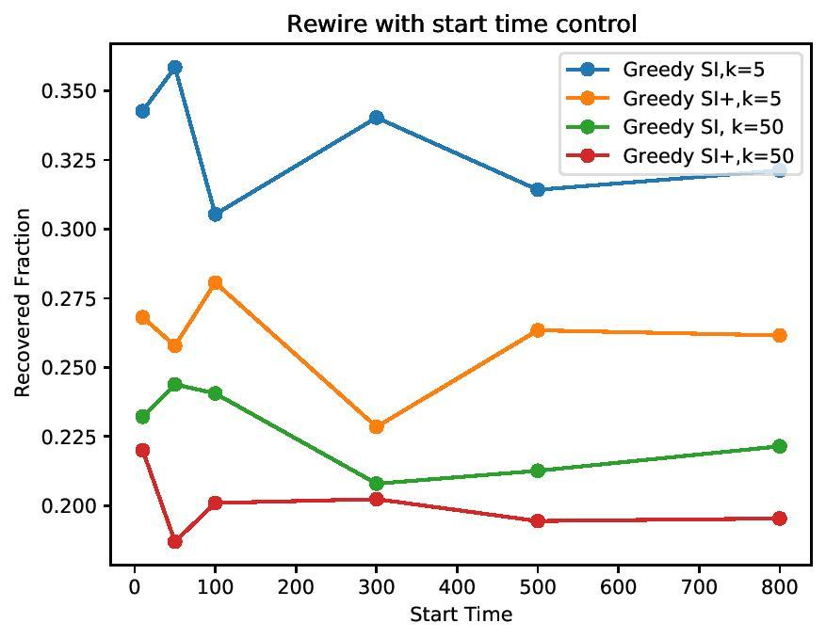
Experiment 3: Varying Start time of Intervention
GreedySI requires delayed intervention with high budget
GreedySI+ requires earlier intervention with high budget
GreedySI+ takes advantage of minimizing the upper bound of the threshold of an outbreak in an earlier stage

Slide 11
Conclusions
Immune shielding can be a powerful intervention and drastically reduce epidemic size even in small networks
Cohorting infected I and recovered R might be the key to reach optimality

